Slide 1

SENTIMENTAL ANALYSIS
Presented by:
CH.ROHITH KUMAR (210303124323)
SUDHARNA CHANDRAN(210303105351)
B.MURALI NAIK(210303124294)
V.KIRAN KUMAR(210304124469)
Guided By:
SANDEEP NARENDRA MEHTA
ASSISTANT PROFESSOR,
CSE DEPARTMENT,
PIET,PARUL UNIVERSITY.

Slide 2

Content
Introduction
Background study (Research Paper Summary in Table form - Format shared in next slide)
Objectives of the Project
-What is exactly to be done?
-Why is this project selected?
-Where is the project is helpful?
-When it can be implemented?
-Who will be benefitted?
Project Team: Roles and Responsibilities
Schedule
UML Diagrams
Advantages of the System
Limitations of the System
Conclusion
Future Work
References
Internal Project Presentation 2024 2

Slide 3
INTRODUCTION
Project Definition
Sentiment analysis of face recognition involves analyzing facial expressions to infer emotional states. By employing machine learning algorithms, it aims to detect and interpret emotions such as happiness, sadness, anger, and surprise from facial cues. This technology finds applications in diverse fields like market research, customer service, and mental health monitoring, enabling better understanding and response to human emotions in various contexts..
Project Aim:
The aim of sentiment analysis of face recognition is to accurately detect and interpret emotions from facial expressions, enabling applications such as emotion-aware systems, personalized user experiences, and improved understanding of human behavior in various domains.
Project Presentation 2024 3

Slide 4
Research Papers studied
Sr. number | Paper Title | Publisher | Year | Take-away points
1 | Light Weight Emotion Recognition System of Facial Images using Convolutional Neural Networks | International Journal of Advanced Research in Science, Communication and Technology | 2023 | The provided paper is about a light weight emotion recognition system using facial images. It does not mention any other research papers on sentimental analysis of face recognition
2 | Automatic Detection of Sentimentality from Facial Expressions | Mina bishay | 2022 | The provided paper is about automatic detection of sentimentality from facial Expressions.
3 | Deep Learning-Based Facial Emotion Analysis | Kiran mayer | 2023 | The provided paper is about an ensemble-based face expression recognition approach for image sentiment analysis. It does not provide a list of research papers for sentimental analysis of face recognition
Project Presentation 2024
4

Slide 5
OBJECTIVES OF THE PROJECT :
1. What is exactly to be done?
The project involves developing algorithms or models to analyze facial expressions and infer emotional states accurately. This includes training machine learning models on labeled datasets of facial expressions to recognize patterns associated with different emotions.
2.Why is this project selected?
This project is selected because of its potential to enhance various applications such as customer service, mental health monitoring, and human-computer interaction. By understanding human emotions through facial expressions, systems can provide more personalized and empathetic responses, leading to improved user experiences.
3.Where is the project helpful?
This project is helpful in a wide range of areas including:
- Customer service: Enhancing customer satisfaction by understanding and responding to their emotions. - Mental health: Monitoring emotional states for early intervention and support.
- Human-computer interaction: Creating more intuitive and responsive interfaces.
- Market research: Understanding consumer preferences and reactions to products and advertisements
Project Presentation 2024 5

Slide 6
4. When can it be implemented? -
Implementation can begin once the necessary technology infrastructure is in place, including access to facial recognition software, datasets for training models, and computing resources for processing and analysis. Depending on the complexity of the project, implementation timelines may vary
5. Who will be benefited?
The beneficiaries of sentiment analysis of face recognition include:
- Customers: Improved service and experiences tailored to their emotions.
- Individuals: Better mental health support and interventions.
- Businesses: Enhanced understanding of consumer behavior and preferences.
- Researchers: Insights into human emotion and behavior for various studies and applications.

Slide 7
Project Team: Roles and Responsibilities
Sr. number Team memeber Enrollment number Role Responsibility
1 | CH.ROHITH KUMAR | 210303124323 | Full stack developer (front-end) | Developing user interface
2 |  |  | Computer Vision Engineer | Develops and implements face recognition algorithms for sentiment analysis, ensuring accurate identification of facial expressions and emotions
 | SUDHARNA CHANDRAN | 210303105351
3 | B. MURALI NAIK | 210303124294 | Data Analyst | Collects the required data analysis the data related facial experssions
4 | V.KIRAN KUMAR | 210304124469 | Machine Learning Engineer: | machine learning developer specializing in sentiment analysis through facial recognition.
Project Presentation 2024
6

Slide 8
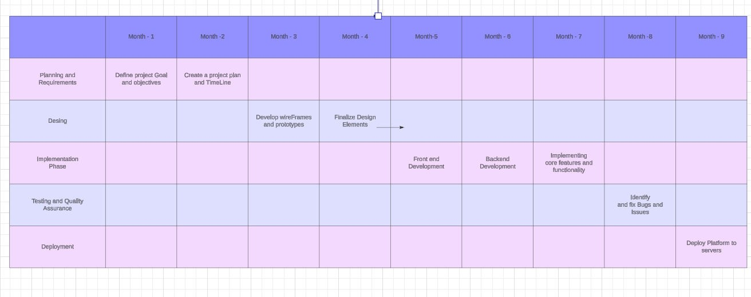
Time Line Chart - Schedule
Project Presentation 20

Slide 9
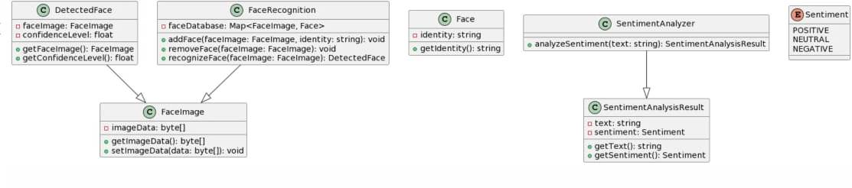
UML DIAGRAMS
1)Use Case Diagram:

Slide 10
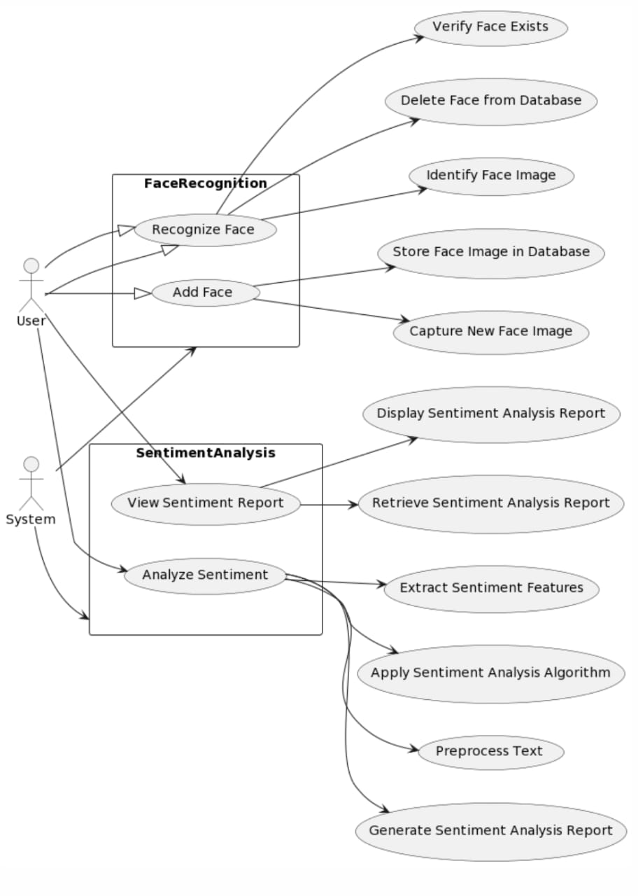
ACTIVITY DIAGRAM:

Slide 11
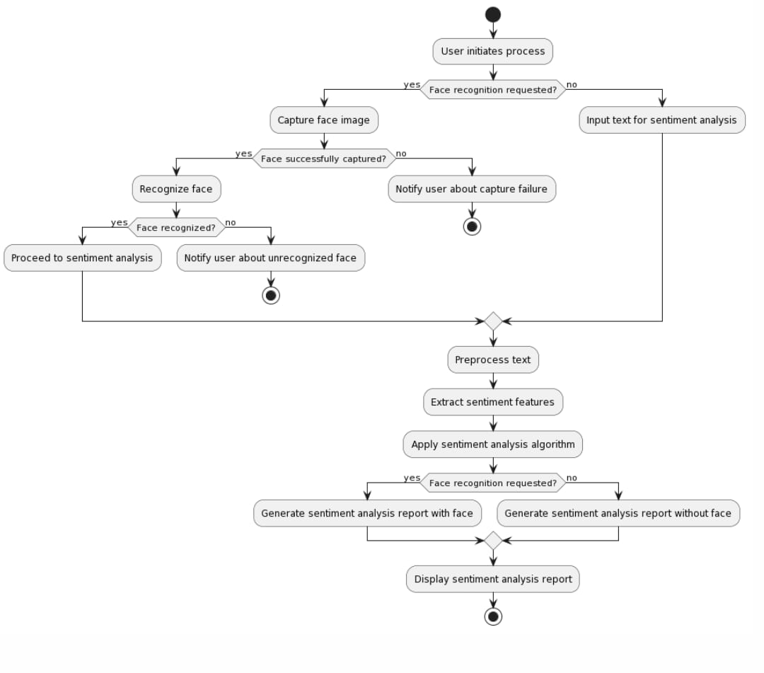
CONTROL FLOW DIAGRAM:

Slide 12
Advantages of the System:
1.Enhanced Interaction:
Explanation: Helps computers understand emotions in facial expressions, making interactions more natural and responsive, like recognizing when someone is happy or sad.
2. Personalized Experiences:
Explanation: Enables systems to adapt based on detected emotions, offering personalized content or responses to match the user's mood and preferences.
3. Improved User Engagement:
Explanation: Enhances user engagement by tailoring experiences to emotional cues, creating a more empathetic and enjoyable interaction with technology.
4. Enhanced Security Measures:
Explanation: Strengthens security by incorporating sentiment analysis into face recognition, allowing systems to identify and respond to emotional anomalies for improved safety and monitoring.

Slide 13
Limitations of the System
1.Expression Misinterpretation:
Explanation: The system may struggle to accurately interpret complex facial expressions, leading to potential misjudgments of emotions.
2. Cultural Sensitivity:
Explanation : Recognizing emotions can vary across cultures, causing the model to misinterpret expressions not accounted for in its training data.
3. Privacy Concerns:
Explanation: Applying sentiment analysis on facial data raises privacy issues, as it involves handling personal information, potentially causing discomfort among users.
4. Limited Emotional Insight:
Explanation: The system might have difficulty capturing nuanced emotions, limiting its ability to provide a comprehensive understanding of a person's emotional state.

Slide 14
Conclusion
using sentiment analysis with face recognition is a cool idea for making technology more understanding. It can make our interactions feel more human. But we also need to remember that it's not always perfect and has some things it can't do well, like understanding all emotions accurately. So, while it's exciting, we should keep working on making it better and think about privacy too

Slide 15
Future Work
Fine-grained emotion recognition:
Identifying subtle variations in emotions from facial expressions.
2.. Cross-cultural and multimodal analysis:
Analyzing emotions across different cultures and integrating multiple data sources.
3. Real-time processing:
Analyzing facial expressions instantly for immediate responses.
4. Privacy-preserving techniques:
Protecting individuals' privacy while analyzing facial data.
5. Longitudinal analysis:
Studying changes in emotional states over time.
Project Presentation 2024
18

Slide 16
References
deepface: A deep learning facial analysis library.
OpenCV: An open-source computer vision library.
Haar cascade classifier XML file: For face detection.
.
Project Presentation 2024
19

Slide 17

Project Presentation 2024
20

